Slide 1
Microsoft Ignite

Slide 2
Elevating Construction: Realtime Optimization using Digital Twin and AI
Aaron J. Drake

Slide 3
Agenda
Mathematical Foundations
New Seeds in 2025
Azure Demos
Digital Twin
AI Foundry X Digital Twin

Slide 4
Notes:
Slide is intentionally blank white space, Will speak to a story about invention Cartesian Coordinate system

Slide 5
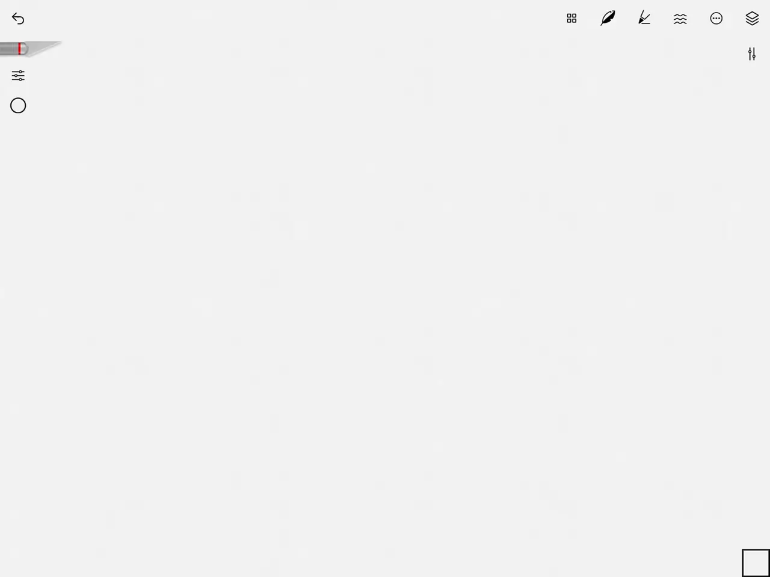

Slide 6

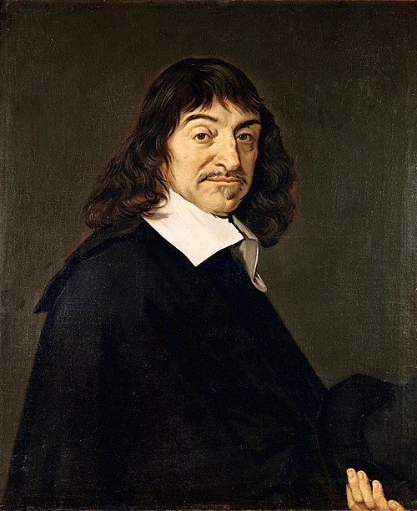
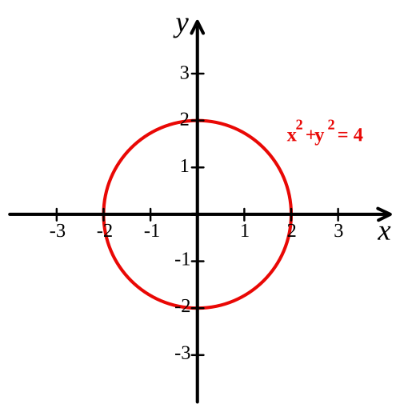
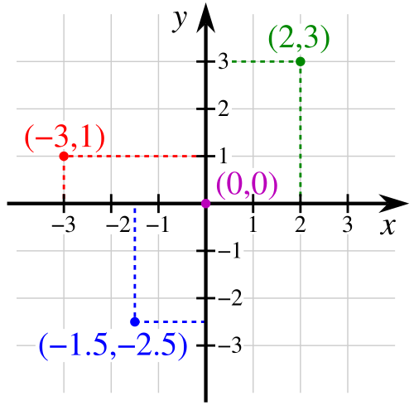
Cartesian Coordinate System
Invented in 1637, is now a STEM primitive.
René Descartes

Slide 7
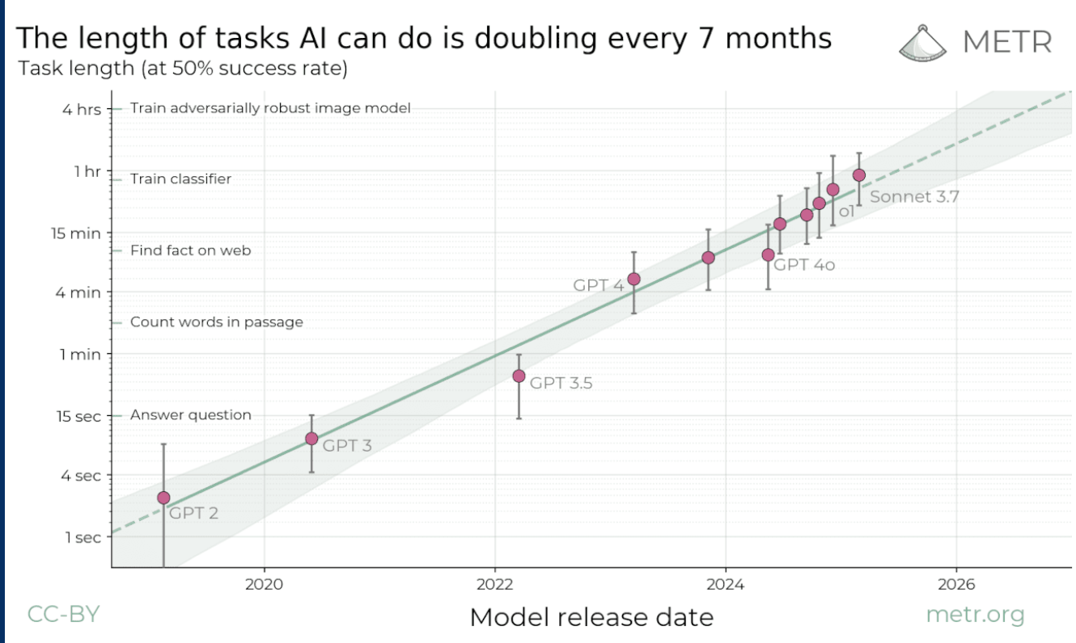
Credit: Mary Ann Freeman, Senior Director of Engineering, AI and Data Science, MathWorks
Notes:
Example of cartesian coordinates in used 2025

Slide 8
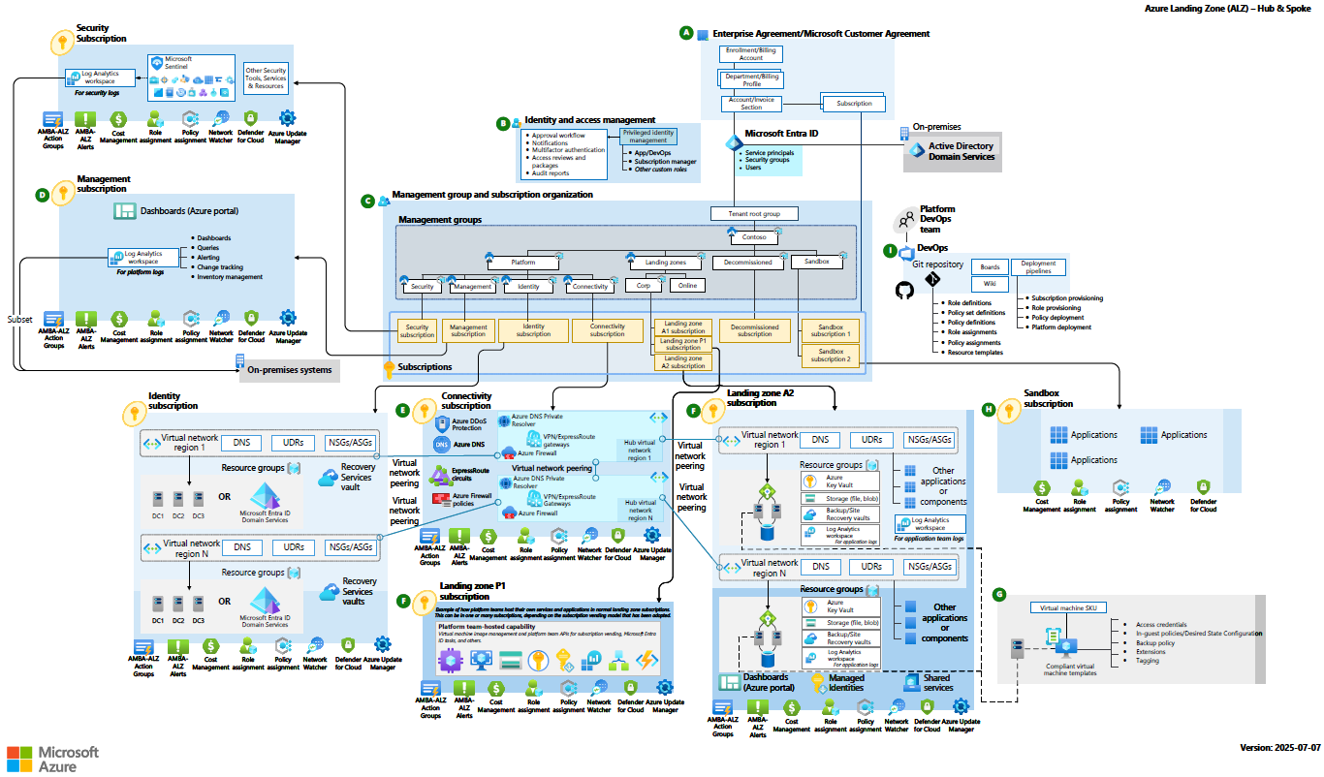

Slide 9
Azure Digital Twin Demo
A digital twin is a "living" model that continuously synchronizes with its physical counterpart via a "digital thread" of live data
Simulation and Scenario Planning
Real-time Monitoring
Notes:
Digital twins allow for virtual prototyping and clash detection between architectural, structural, and MEP (mechanical, electrical, and plumbing) models, minimizing errors and costly rework later.

Slide 10
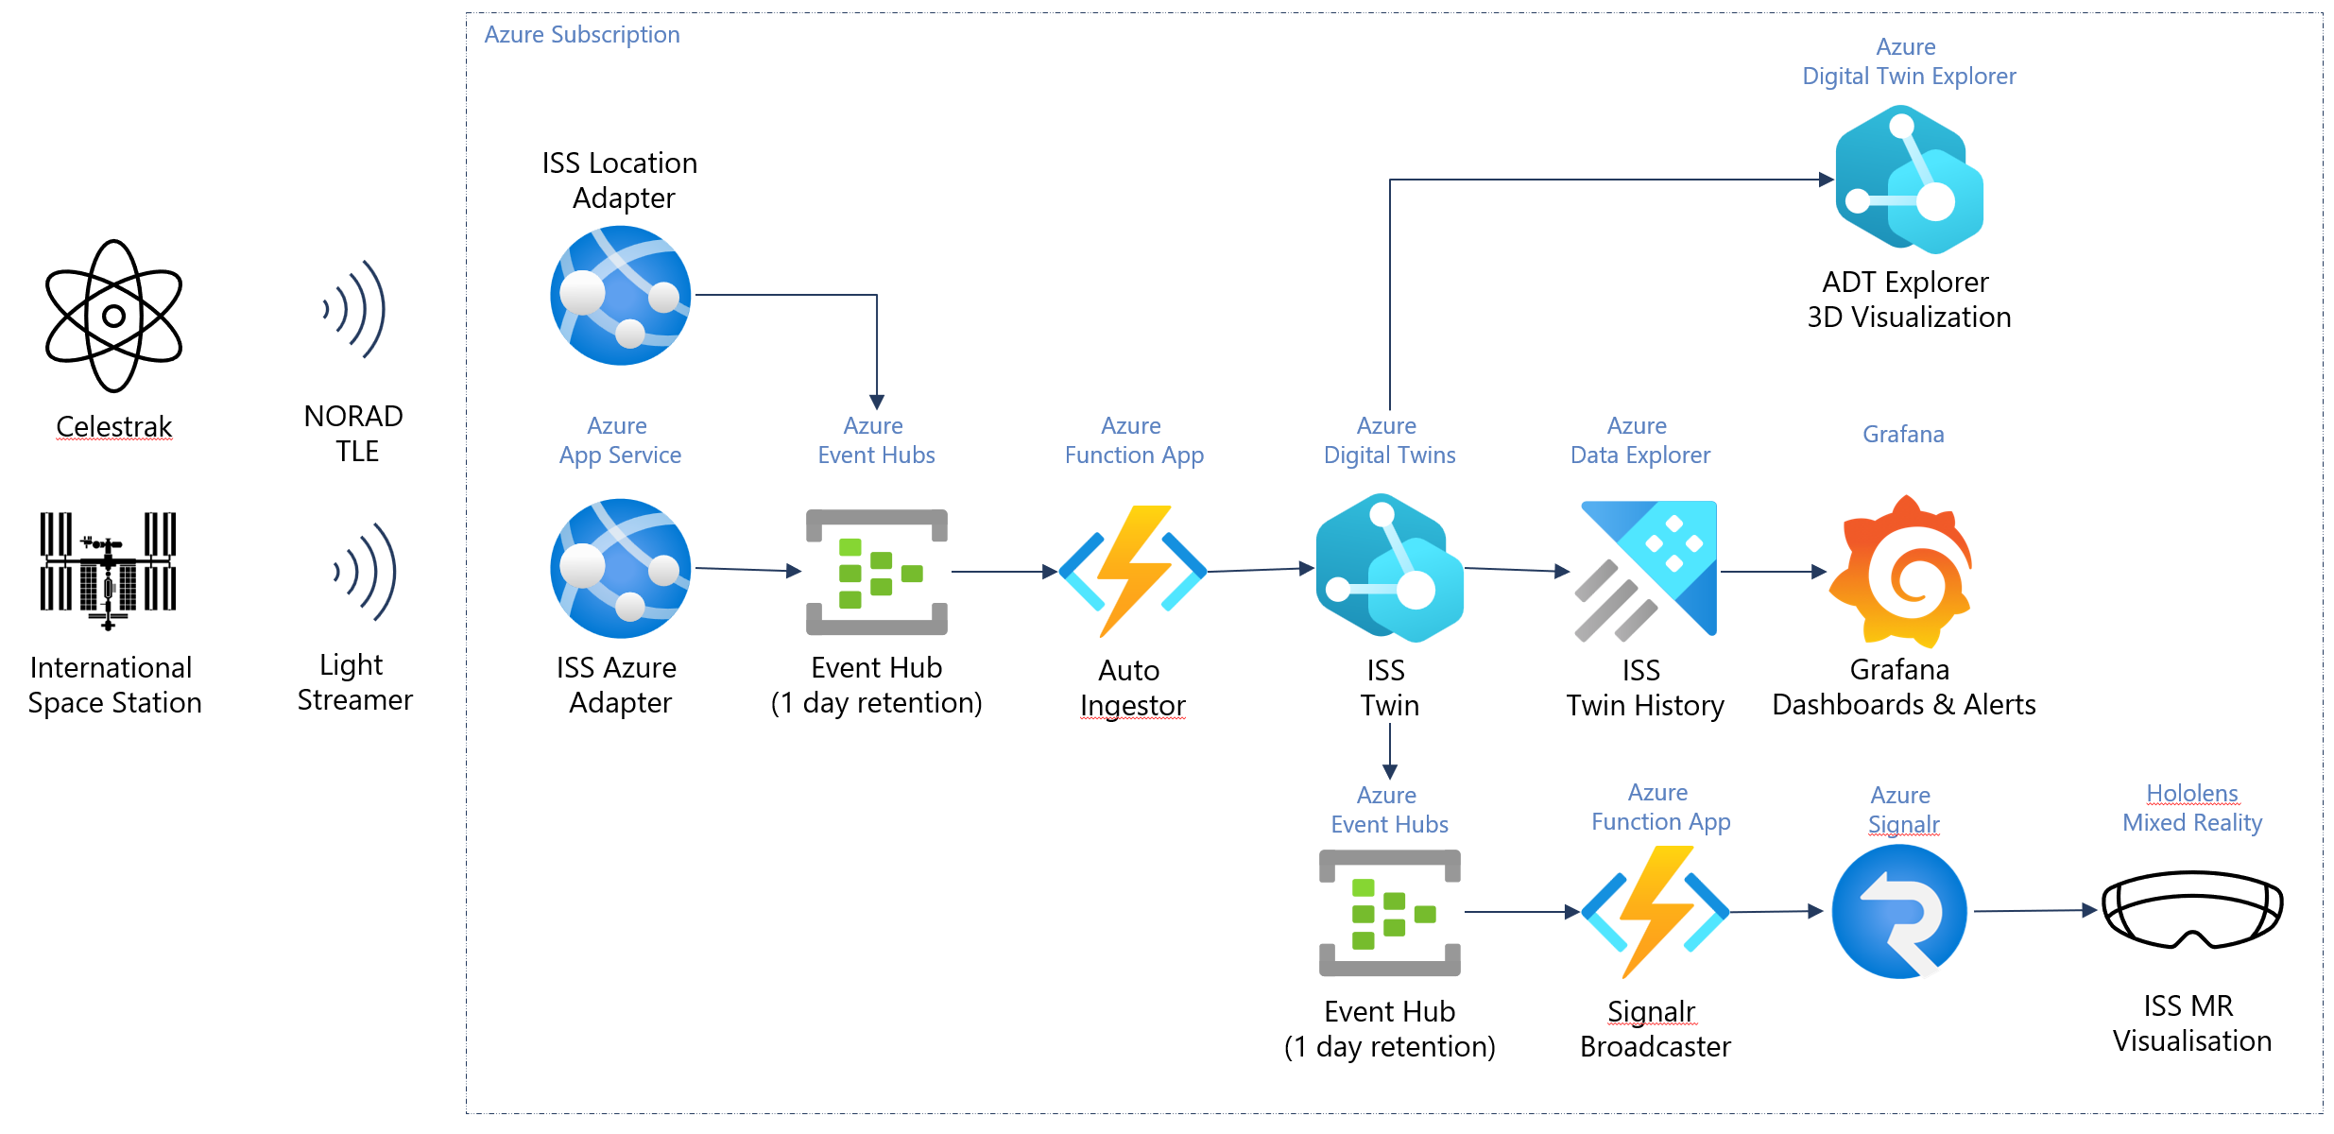

Slide 11
AI Foundry X Digital Twin
Realtime simulation and prototyping
Digital twins with AI allow assisted design review and Realtime monitoring during build and manage phases of physical construction

Slide 12


Aaron J. Drake
Aaron J. Drake is a Cloud-focused software architect specializing in AI transformation and is founder of Adapt, LLC, a Microsoft Partner.
In addition to having MBA and BS in CS degrees, also holds a CISSP designation.
aaronjdrake@adapt-llc.com

Slide 13





Thank You to our sponsors
And next time - Your Company!

Slide 14


Please share your event and session feedback!
http://aka.ms/MSIgniteNYCSurvey
http://aka.ms/MSIgniteNYCSessionsSurvey

Slide 15
Questions?

Slide 16
Citations
Wikipedia contributors. "Cartesian coordinate system." Wikipedia, The Free Encyclopedia. Wikipedia, The Free Encyclopedia, 13 Oct. 2025. Web. 21 Nov. 2025
Measuring AI Ability to Complete Long Tasks
arXiv:2503.14499 [cs.AI] https://arxiv.org/abs/2503.14499 Azure landing zone architecture
https://learn.microsoft.com/en-us/azure/cloud-adoption-framework/ready/landing-zone/
Tracking the ISS with Azure Digital Twins
https://github.com/azure-samples/azure-digital-twins-getting-started/tree/main/ISS

